Slide 1
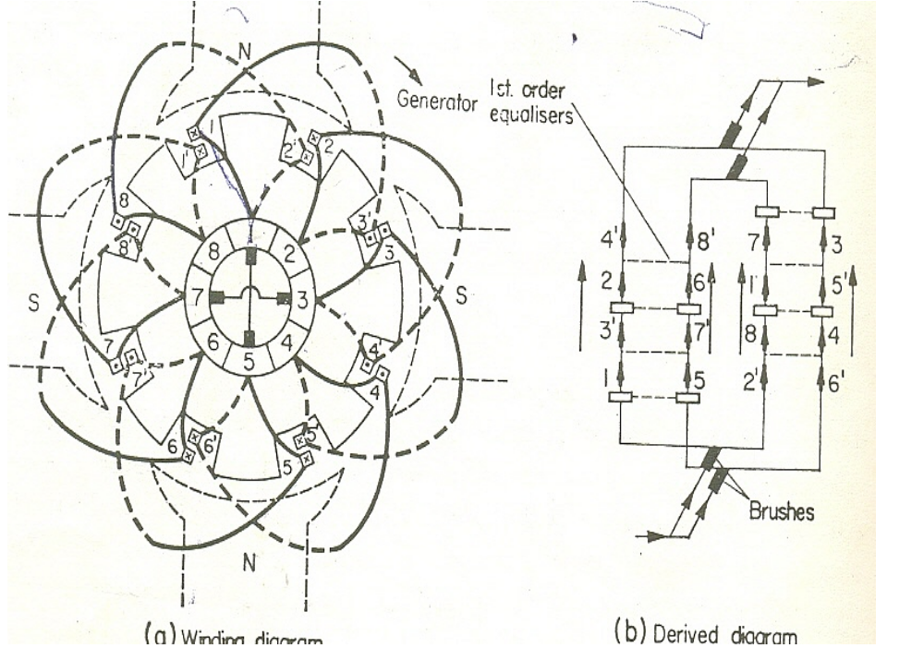
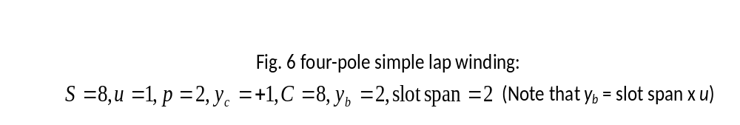
Simple lap winding

Slide 2
    Determining type of machine when direction of rotation is given:
      In generators, torque is in direction opposite to that of the speed, whereas in motors, torque and speed are in the same direction.

Slide 3
      Therefore, when we know the direction of the speed and the direction of the torque, we can tell the type of machine.
      The torque direction is determined as shown in Fig. 7

Slide 4
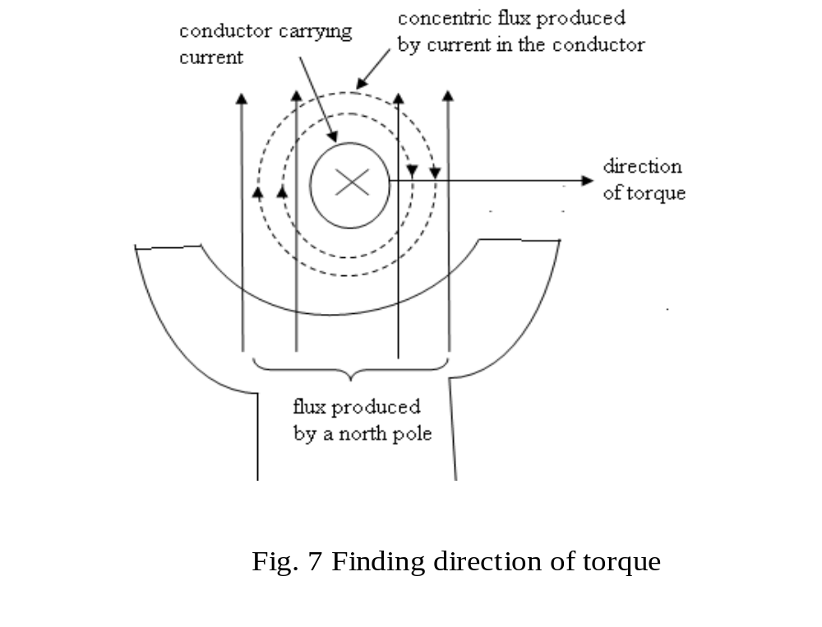

Slide 5
Exercise 1
The machine in Fig. 6 is operating as a generator with the armature rotating in the clockwise direction. Determine the direction of the current in conductors 1 and 1’

Slide 6
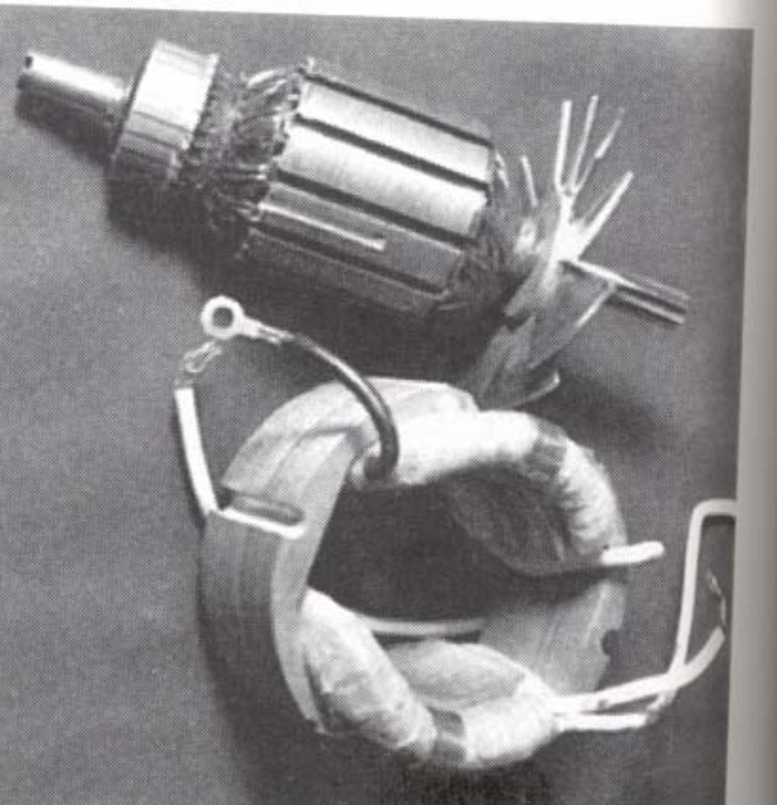
Ratio of pole arc to pole-pitch
In practical machines, this varies
from 0.67 to 0.75
Brushes
no. of brushes = no. of poles
they are equally spaced
in their normal or neutral position, they short coils which have their sides moving through low-flux inter-polar zone.

Slide 7
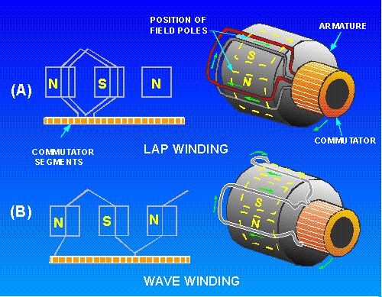
Parallel paths:
number of parallel paths = number of poles
a parallel path consists of all top-layer conductors under one pole, together with all the bottom-layer conductors under one neighbouring pole.

Slide 8
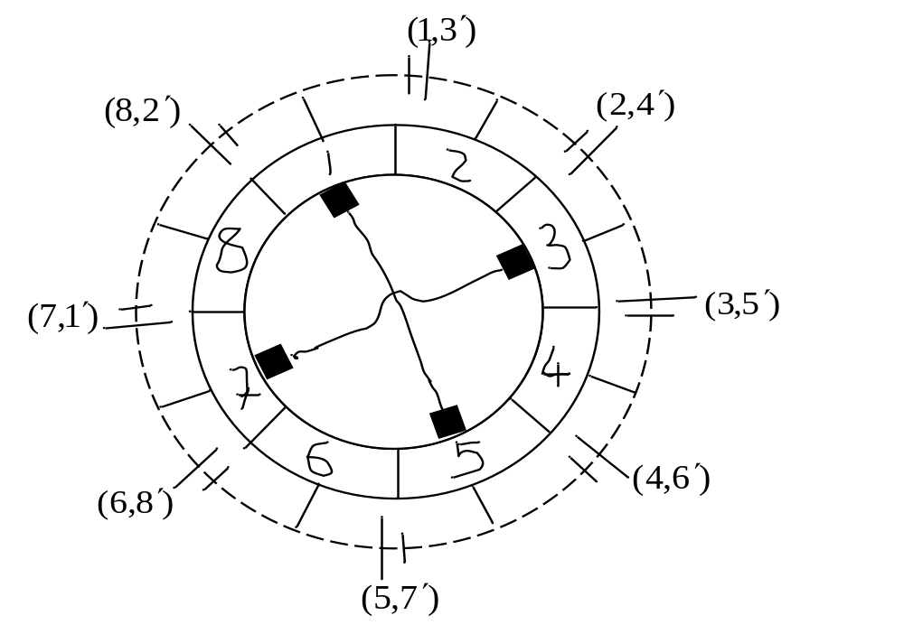
  Fig. 8 Diagram showing parallel paths of machine in Fig. 6

Slide 9
Total emf
The total resulting emf induced between brushes is not completely constant.
Variations arise as rotor changes position.

Slide 10
See Fig. 6. With the rotor displaced through one-half the commutator segment. The displacement will result in four coils being short-circuited.
In practical machine the variations are very small. Hence the number of conductors in series per circuit or parallel path is given by Z/2p

Slide 11
Equalizers or Equalizing Rings:
Some dc lap winding machines have equalizers.
The emfs in the parallel paths are supposed to be the same but they are not because practical machines are not perfectly symmetrical.

Slide 12
Equalizers are used so that circulating currents caused by slight discrepancies in the generated emfs in the parallel paths will flow through them rather than through the brushes

Slide 13
An equalizer connects together all noses of coils or commutator segments which should be at the same potential or which are exactly similarly situated with respect to the magnetic system
The number of top layer coil sides which can occupy identical positions relative to the magnetic system = p.

Slide 15
If the necessary condition is fulfilled for the p coil sides to occupy identical positions then the coils in the winding can be divided into C/p groups, each group consisting of p coils occupying the same identical positions.

Slide 16
For top layer coil sides to occupy identical positions relative to the magnetic system, the ratio S/p must be an integer.
This condition must be fulfilled if equalizers are to be used.

Slide 17
In the design of lap windings, it is required that S/p be an integer.
Note that when S/p is an integer then C/p = (S/p)u is also an integer.
Number of coils connected to equalizer = number of coils occupying identical positions = p.

Slide 18
Not every coil or commutator segment is equalized with that of correspondingly situated coils.
If all coils are to be equalized then C/p equalizers will be required.
It generally suffices to use 10 to 20 equalizers.

Slide 19
Equalizers are arranged so that tappings to the various equalizers, which may be connected to commutator segments or noses of the coils, shall be equally spaced.

Slide 20
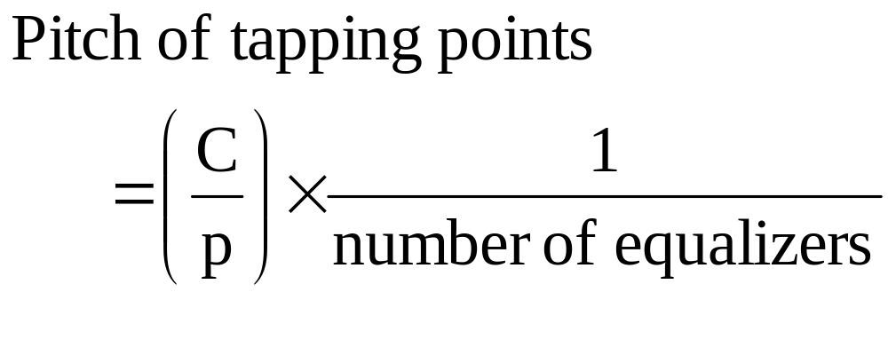
The pitch must be an integer.
With the maximum number of equalizers C/p pitch of tapping points = 1

Slide 21
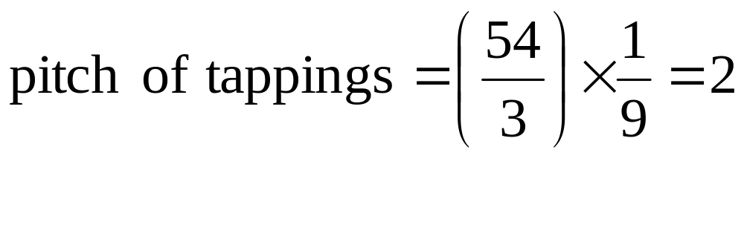
For example, if S =27, p = 3, C = 54 and no. of equalizers = 9, then
The equalizers will be connected to the commutator segments as shown in Table 1.

Slide 22
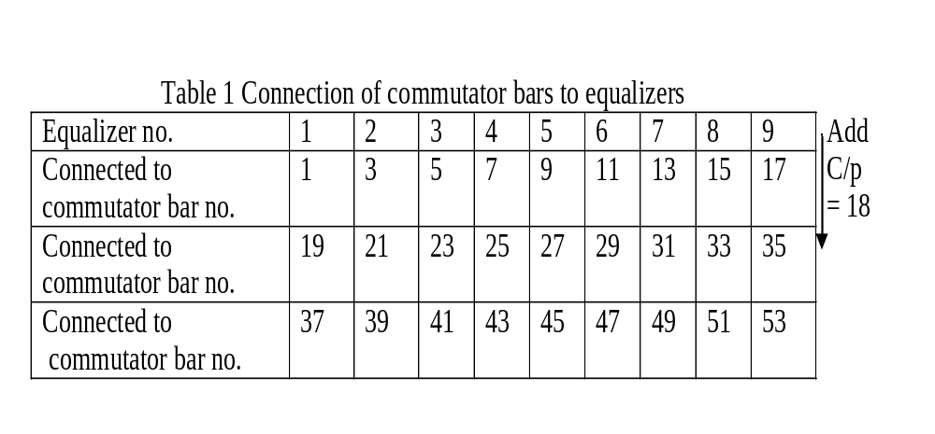

Slide 23
For the simple lap winding machine in Fig. 6, the max. no. of equalizers that we can use is C/p = 8/2 = 4.
If we decide to use 2, then the pitch of tapping is = 4/2 = 2.

Slide 24
Refer to Fig. 6 b for the connections of the commutator segments to 4 equalizers and
Fig. 9 for the connections to 2 equalizers.

Slide 26
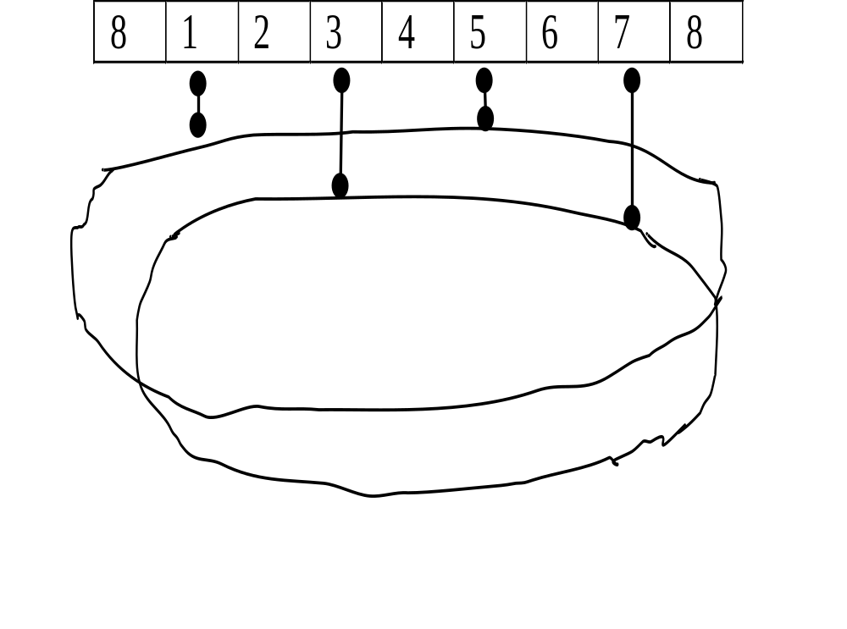

Slide 27
Generally, the no. of slots used is a multiple of the no. of poles (i.e. S/2p is an integer) so that full-pitch windings are possible.
In this case, equalizers can also be used because if S/2p is an integer then S/p is also an integer.

Slide 28
Exercise 2
The total number of conductors in each parallel path of an 8-pole simple lap winding must be greater than 94 and less than 102. The number of slots per pole must also be greater than 12 and less than 18. Determine:

Slide 29
the maximum and minimum number of conductors per slot. [Hint: (Z/S)_{max} = Z_{max}/S_{min} and (Z/S) _{min} = Z_{min}/S_{max} ]
the number of conductors per slot
the number of coils per slot if u should be greater than 1.
the number of slots/pole

Slide 30
Exercise 3
A simple lap winding has the following particulars: C = 384, p = 4. Not less than 10 and not more than 15 equalizers must be used. Find the number of equalizers.

